Slide 1
CS520 Web Programming
Spring – Web MVC
Chengyu Sun
California State University, Los Angeles

Slide 2
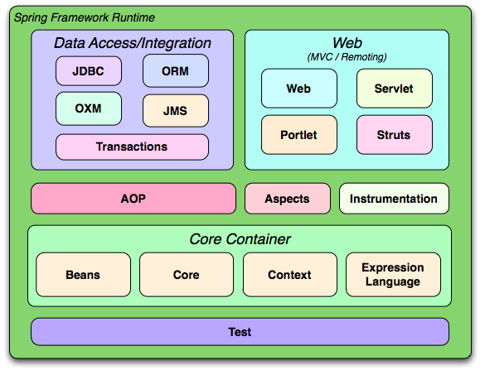
Spring Framework

Slide 3
Roadmap
Introduction to Spring MVC
Database access
Controllers
Message bundle and input validation

Slide 4
The SpringMVC Example
Spring and Hibernate from Scratch
  http://csns.calstatela.edu/wiki/content/cysun/course_materials/cs520/sham/

Slide 5
Add Spring MVC to A Maven Webapp
Spring dependencies
  spring-webmvc
Front controller
  DispatcherServlet in web.xml
Bean configuration file
  /WEB-INF/<servlet-name>-servlet.xml

Slide 6
Request Processing in Spring Web MVC
Controller
URL
Mapping
URL
Mapping
Controller
Request
Controller
Front
Controller
Controller
Application Server
model
Response
View
View
Resolution

Slide 7
Spring Controllers
Spring controllers are beans annotated with @Controller
In <servlet-name>-servlet.xml
  <mvc:annotation-driven>
  <context:component-scan>

Slide 8
Controller URL Mapping
Requests are mapped to controller methods using @RequestMapping
  value: URL pattern(s)
  Mapping can be further refined by using method, params, and headers
  http://static.springsource.org/spring/docs/current/spring-framework-reference/html/mvc.html#mvc-ann-requestmapping

Slide 9
View
A controller method returns a view name, which will be resolved to a view implementation by a view resolver

Slide 10
Resolve JSP Views
<bean id="viewResolver"
class="org.springframework.web.servlet.view.InternalResourceViewResolver">
<property name="prefix" value="/WEB-INF/jsp/" />
<property name="suffix“ value=".jsp" />
</bean>
Prefix + ViewName + Suffix = JSP File
Why not just return the path to the JSP file??

Slide 11
View Technologies and Resolvers
http://static.springsource.org/spring/docs/current/javadoc-api/org/springframework/web/servlet/ViewResolver.html

Slide 12
Model
Model objects are passed to view using a ModelMap
  put( String, Object )
attribute
name
attribute
value

Slide 13
Request Processing Recap
3
Controller
URL
Mapping
1
URL
Mapping
Controller
2
Request
Controller
Front
Controller
Controller
Application Server
5
model
4
Response
View
Resolution
View
6
7

Slide 14
Database Access Dependencies
Hibernate
Spring ORM
Database connection pooling
  DBCP vs. Tomcat JDBC
Database driver

Slide 15
Configuration
Hibernate JPA
  persistence.xml
Spring
  web.xml
  applicationContext.xml

Slide 16
Spring Transaction Management
Transaction management code is added through AOP
<context:annotation-config> enables annotations like @Autowired and @PersistenceContext
<tx:annotation-driven> enables annotations like @Transactional

Slide 17
Model Classes and Database
Model classes, e.g. User
  JPA annotations
Database
  SQL scripts
  hibernate_sequence

Slide 18
Database Access
DAO interfaces, e.g. UserDao
DAO implementations, e.g. UserDaoImpl

Slide 19
Spring DAO Annotations
@Repository for DAO implementation classes
@PersistenceContext injects an entity manager to the class
@Transactional for methods that write to the database

Slide 20
Controller Examples
List all users
Display a selected user
Add a new user
Edit a user

Slide 21
Example: List All Users
Controller basics
  @Controller
  @RequestMapping
  @ModelMap
  Using DAO

Slide 22
Example: Display A User
Using @RequestParam
  required
Using @PathVariable

Slide 23
Example: Add A User
Model attribute (a.k.a. command object, form backing object)
  Concept
  Binding
  @ModelAttribute
@RequestMapping
  method
The “redirect” view

Slide 24
Command Object
HTML Form
model attribute
Binding
public class User {
String username;
String password;
…
}
Usename:
Password:
Login
Bind form fields to properties of the object

Slide 25
Handling Forms
One controller method for
  Creating a model attribute
  Returning the form view
Form view
  Use Spring <form> tags to bind the model attribute to the form
One controller method for
  Processing the command object (annotated with @ModelAttribute)
  Returning the success view

Slide 26
Spring’s form Tag Library
Documentation - http://static.springsource.org/spring/docs/current/spring-framework-reference/html/view.html#view-jsp-formtaglib
Tag reference – http://static.springsource.org/spring/docs/current/spring-framework-reference/html/spring-form.tld.html

Slide 27
Example: Edit A User
Store model attribute in session
  @SessionAttributes
  SessionStatus
    Use setComplete() to remove the model attribute in session

Slide 28
Non-Session Model Attributes
Form request
Form Submission
Create a model
attribute in controller
Create a model
attribute
Populate the model
attribute with submitted
data
Use the model
attribute to populate
the form fields in view
Pass the model
attribute to controller

Slide 29
Session Model Attributes
Form request
Form Submission
Create a model
attribute in controller
Retrieve the model
attribute from session
Save the model
attribute in session
Populate the model
attribute with submitted
data
Use the model
attribute to populate
the form fields in view
Pass the model
attribute to controller

Slide 30
Message Bundles
Separate text messages from application code and put them into their own files
  E.g. messages.properties
error.username.required=A username is required.
error.password.short=The password is too short.
error.username.taken=The username {0} is already taken.

Slide 31
Advantages of Using Message Bundles
Change text messages without modifying the source code
Internationalization (I18N)
  messages.properties
  messages_en_US.properties
  messages_zh_CN.properties
  …

Slide 32
Using Message Bundles with JSTL
<fmt:setBundle basename="messages" />
<fmt:message key="msg1">
<fmt:param value="Chengyu" />
</fmt:message>
<fmt:message key="msg2" />

Slide 33
Using Message Bundles with Spring
Declare a messageSource bean
<spring:message> tag
<spring:message code="msg1"
arguments="Chengyu" />
<spring:message code="msg2" />

Slide 34
Input Validation in Spring
Implement a Validator
Add a BindingResult parameter to the controller method
Return the form view if validation fails
Display errors using <form:errors>

Slide 35
Example: Validate Add/Edit User
Add error messages to the message bundle
Implement a validator and wire it to the controller
Validate
Display error messages

Slide 36
Other Validation Options
JavaScript validation
  jQuery Validation plugin - http://bassistance.de/jquery-plugins/jquery-plugin-validation/
Commons-validator
  http://commons.apache.org/validator/
  Provide both declarative and programmatic validation

Slide 37
Commons-Validator Declarative Validation Example
<form name=“fooForm">
<field property=“name“ depends="required">
<arg0 key=“fooForm.definition"/>
</field>
<field property="difficultyLevel"
depends="required, integer">
<arg0 key=“fooForm.difficultyLevel"/>
</field>
</form>

Slide 38
Commons-Validator Routines
http://commons.apache.org/proper/commons-validator/javadocs/api-1.4.0/org/apache/commons/validator/routines/package-summary.html
Independent of the declarative validation framework
A set of methods to validate
  Date and time
  Numeric values, currency
  ...

Slide 39
Access HTTP Request, Response, and Session
Simply add an argument of that type to the controller method
http://static.springsource.org/spring/docs/current/spring-framework-reference/html/mvc.html#mvc-ann-arguments

Slide 40
Readings
Spring Framework Reference Document, Chapter 17 - http://static.springsource.org/spring/docs/current/spring-framework-reference/html/mvc.html

